Slide 1
Marketing & Sales Performance Analysis
By Kumkum soni
Data Analyst

Slide 2
01
Project Overview
Add a short description
CONTENTS
02
ANALYSIS USING CHARTS
03
summarizing
04
conclusion

Slide 3
01
project overview
This project analyzes marketing and sales performance to understand revenue drivers, campaign efficiency, platform effectiveness, and client contribution.
Using Python and exploratory data analysis (EDA), we identify key trends, opportunities, and areas where strategic improvements can maximize ROI and business growth.

Slide 4

Methodology & Tools
Tools Used: Python, Pandas, NumPy, Matplotlib
Process:
Data loading and cleaning
KPI creation (CPC, CPS, Profit, ROI metrics)
Exploratory Data Analysis
Visualization and trend identification
Insights and strategic recommendations

Slide 5
Key Metrics Engineered
To better analyze marketing efficiency, several KPIs were calculated:
CPC (Cost Per Click)
=AdSpend / Clicks
CPS (Cost Per Sale)
= AdSpend / ItemSales
Revenue Per Click
= Revenue / Clicks
Profit
= Revenue − AdSpend
The mean CPC = ₹61.15
The max CPC = ₹119.90
The min CPC = ₹2.50
The mean CPS = ₹214.75
The max CPS = ₹3578.82
The min CPS = ₹4.64
The mean RPC = ₹30.42
The max RPC = ₹712.54
The min RPC = ₹0.63
The mean Profit =₹276813.2
The max Profit = ₹663501
The min Profit = ₹108254

Slide 6
02
Analysis using charts
Add a main point

Slide 7
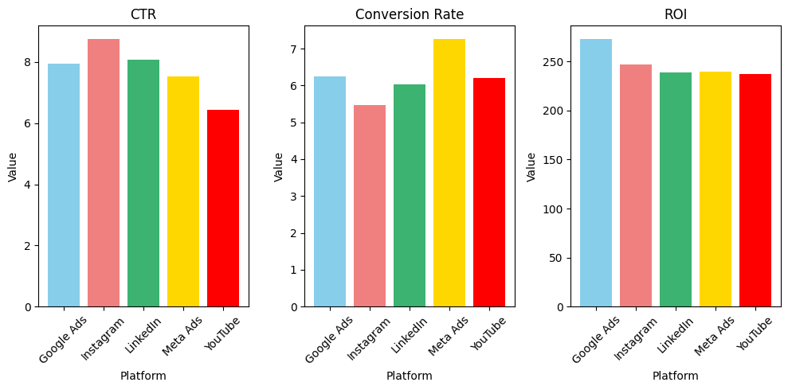
platform performance
Average CTR, Conversion Rate, and ROI were compared across platforms.
Findings:
Some platforms deliver higher engagement and conversions : Meta Ads and Youtube
Others have high cost and low return : Instagram
Clear opportunities to optimize budget allocation and shift investment toward top performers : Meta Ads
content here, or by copying your text

Slide 8
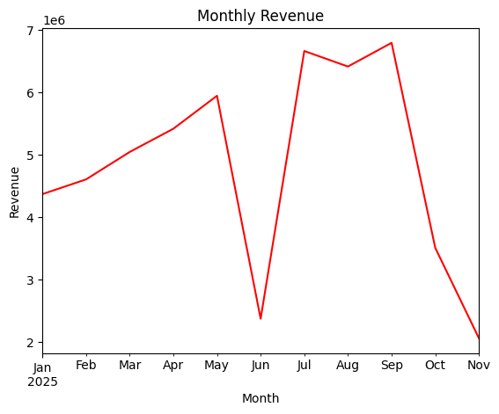
YOUR TITLE HERE
Add a short description
Revenue Insight
Significant variation observed in monthly revenue
Highest earning months indicate strong seasonal patterns
Revenue trend highlights periods of peak customer activity
Useful for future forecasting and budget planning

Slide 9
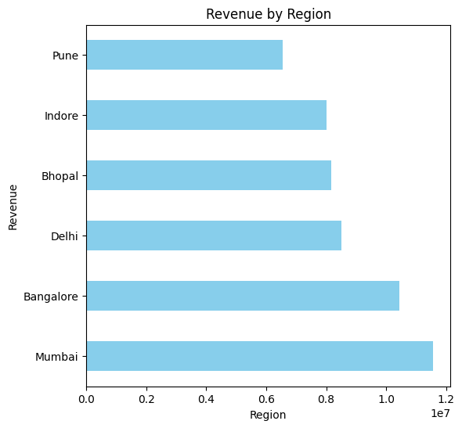
Regional Revenue Performance
High Revenue
Regions contribute the majority of revenue
Mumbai (Rs.11,56,135)
Bangalore(Rs.10,44,072)
Low Revenue
Underperforming regions indicate weak market penetration
Pune and Indore

Slide 10
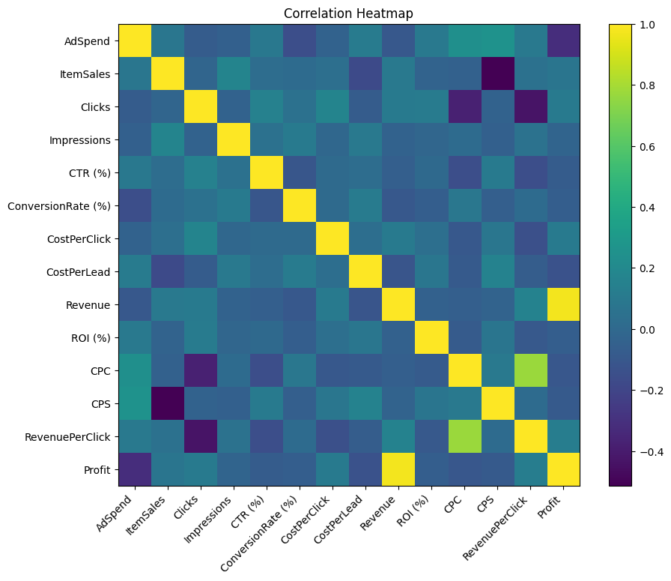
Correlation Analysis
Strong positive correlation observed between Clicks, ItemSales, and Revenue
AdSpend correlates with revenue but not always with profitability
CPC and CPS provide further insight into marketing efficiency
Helps identify the variables most influential for revenue generation

Slide 11
Campaign Performance regional
Region | Revenue | AdSpend | Clicks | ItemSales
Mumbai | 1156133 | 243342 | 1057927 | 23112
Bangalore | 1044070 | 181969 | 834473 | 21089
Bhopal | 817364 | 225137 | 853573 | 19989
Delhi | 849019 | 156620 | 739991 | 18278
Indore | 798467 | 193814 | 836170 | 16861
Pune | 640276 | 120028 | 809340 | 16410
Regions with higher Clicks and ItemSales generally produce higher revenue.

Slide 12
03
summarizing
It presents a key summary of all the important highlights above to provide key notes.

Slide 13
Key Insights Summary
Revenue
Region
Revenue is concentrated among top clients and regions
Some regions and campaigns underperform and require reevaluation
Platforms
Seasonal
Several platforms show strong marketing efficiency
Seasonal trends are present, indicating predictable behavior

Slide 14
Strategic Recommendations
Add a short description
Instagram
Youtube
Mumbai
Reach
Increase investment in top-performing platforms and campaigns
Develop targeted marketing plans for high-revenue regions
Introduce forecasting to support sales planning and budgeting

Slide 15
Future-Focused Strategic Recommendations
Build a Predictive Customer Segmentation Model
Launch a Multi-Region Growth Experimentation Program
Predict churn risk and intervene early.
Protects the business from over-reliance on a few top clients.
Reduces risk while opening new markets safely.
Implement Full-Funnel Platform Optimization
Create a Long-Term Retention Framework for Top Clients
Prioritize platforms with high CTR and ROI for awareness campaigns.
Exclusive loyalty deals
Priority support

Slide 16
04
conclusion

Slide 17


This analysis provides clear insights into the drivers of marketing and sales performance.
By optimizing platform spend, strengthening high-performing campaigns, and focusing on profitable clients and regions, the business can significantly improve ROI and revenue outcomes.
Further strategic details, visuals, and executive recommendations are presented in the accompanying slides.

Slide 18
THANK YOU
For the complete analysis, code, and interactive notebook, please visit my project portfolio.

